Slide 1
Efficient Core Maintenance in Dynamic Graphs
Presented By:
Yumi Kansakar
07/02/2021

Slide 2
Outline
Introduction
Problem Definition
Algorithms
Experiments
Results
Conclusion
Future Works
References

Slide 3
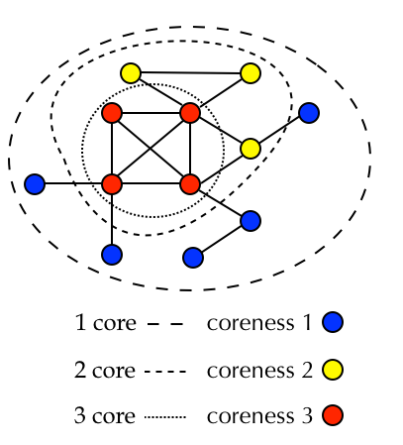

Introduction
Dense Subgraph
K-Core of Graph :
Given a graph $G\left(V,E\right)$and an integer k,
the k-core is a maximal connected subgraph
of $G$ where each vertex has degree at least k
Core Maintenance

Slide 4
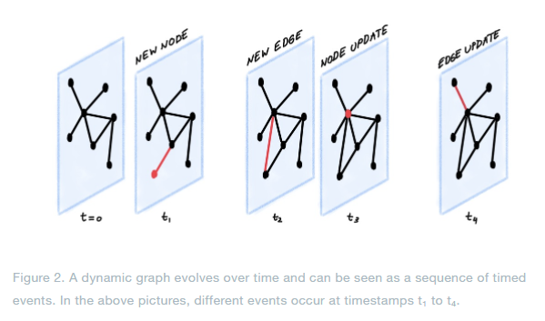

..Introduction
Dynamic Graphs
Social Network
[1]

Slide 5
Problem Definition
Time efficient core maintenance of dynamic graphs.

Slide 6
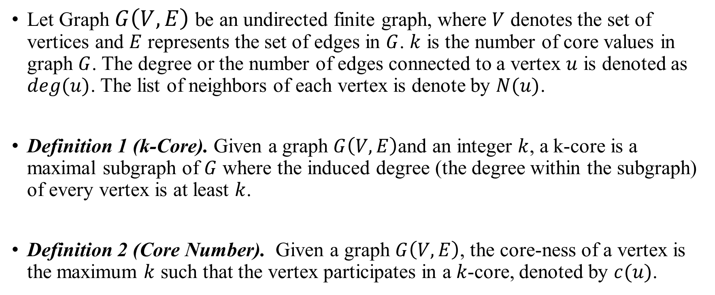
Preliminaries
Let Graph $G\left(V,E\right)$ be an undirected finite graph, where $V$ denotes the set of vertices and $E$ represents the set of edges in $G$. $k$ is the number of core values in graph $G$. The degree or the number of edges connected to a vertex $u$ is denoted as $deg(u)$. The list of neighbors of each vertex is denote by $N(u)$.
Definition 1 (k-Core). Given a graph $G\left(V,E\right)$and an integer $k$, a k-core is a maximal subgraph of $G$ where the induced degree (the degree within the subgraph) of every vertex is at least $k$.
Definition 2 (Core Number). Given a graph $G\left(V,E\right)$, the core-ness of a vertex is the maximum $k$ such that the vertex participates in a 𝑘-core, denoted by $c(u)$.

Slide 7
Outline
Algorithms
Naïve Core Decomposition
Order-Based Core Maintenance
Modified Core Maintenance Algorithm
Observation
Insertion
Deletion

Slide 8
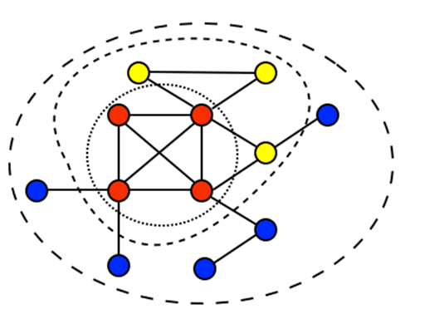
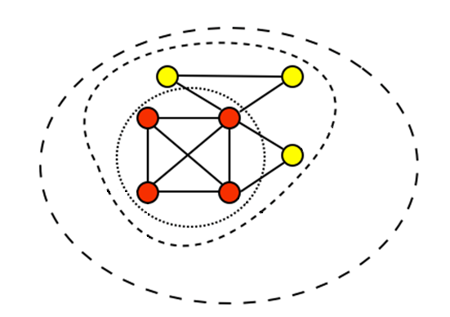
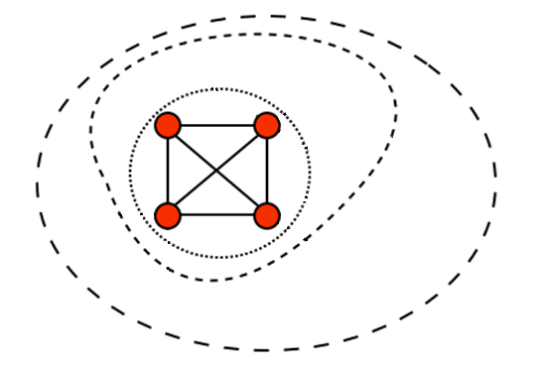
Naïve Core Decomposition
Step-1 : Find 2-core - Remove all nodes with degree =1
Check remaining graph and remove all nodes with degree =1.
Repeat this until all vertices have degree ≥ 2.
Step-2 : Find 3-core - Remove all nodes with degree = 2. Repeat this until all vertices have degree ≥ 3.

Slide 9
Handling Updates
Traversal Approach [3]
Order-based Approach [4]

Slide 10
Modified Core Observation, Insertion and Deletion Algorithm

Slide 11

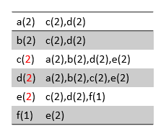
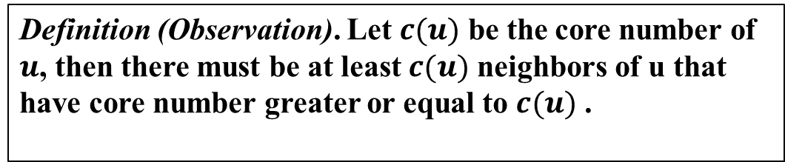
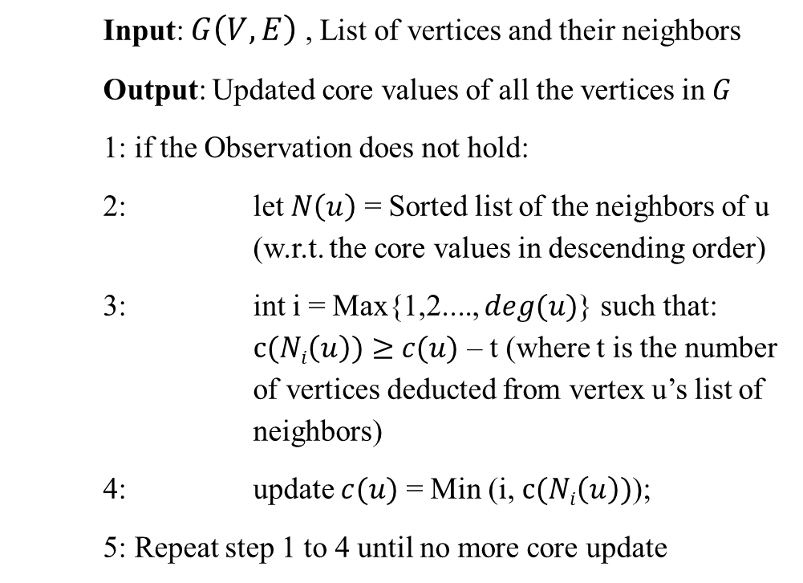
Algorithms: Observation
Example:
Definition (Observation). Let $c(u)$ be the core number of $u$, then there must be at least $c(u)$ neighbors of u that have core number greater or equal to $c(u)$ .
a(2) | c(4),d(4)
b(2) | c(4),d(4)
c(4) | a(2),b(2),d(4),e(3)
d(4) | a(2),b(2),c(4),e(3)
e(3) | f(1),c(4),d(4)
f(1) | e(3)
a(2) | c(4),d(4)
b(2) | c(4),d(4)
c(4) | d(4),e(3),a(2),b(2)
d(4) | c(4),e(3),a(2),b(2)
e(3) | c(4),d(4),f(1)
f(1) | e(3)
Input: $G\left(V,E\right)$ , List of vertices and their neighbors
Output: Updated core values of all the vertices in $G$
1: if the Observation does not hold:
2: let $N\left(u\right)$ = Sorted list of the neighbors of u (w.r.t. the core values in descending order)
3: int i = Max{1,2...., $deg(u)$} such that: $c(Ni\left(u\right))≥$ $c(u)$ – t (where t is the number of vertices deducted from vertex u’s list of neighbors)
4: update $c(u)$ = Min (i, $c(Ni\left(u\right))$);
5: Repeat step 1 to 4 until no more core update

Slide 12
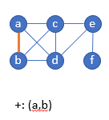

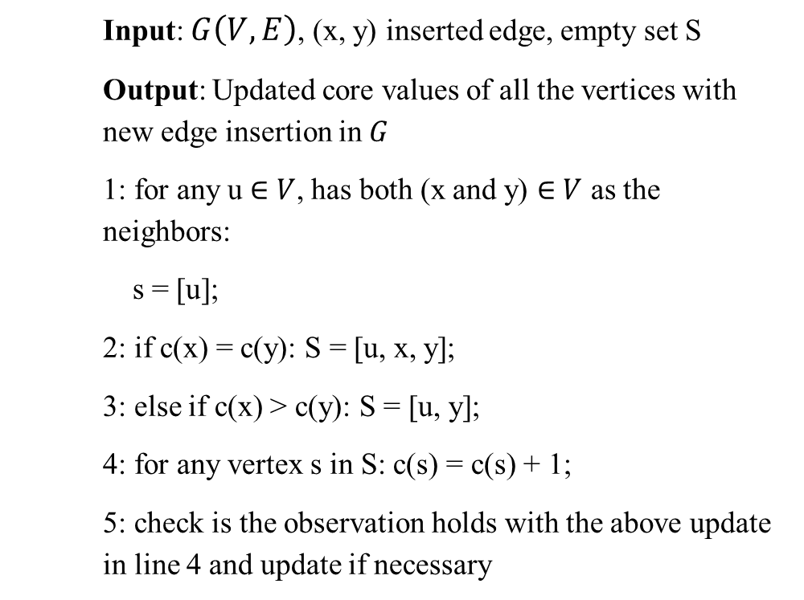
..Algorithms: Insertion
Example:
Input: $G\left(V,E\right)$, (x, y) inserted edge, empty set S
Output: Updated core values of all the vertices with new edge insertion in $G$
1: for any u $∈$ $V$, has both (x and y) $∈$ $V$ as the neighbors:
s = [u];
2: if c(x) = c(y): S = [u, x, y];
3: else if c(x) > c(y): S = [u, y];
4: for any vertex s in S: c(s) = c(s) + 1;
5: check is the observation holds with the above update in line 4 and update if necessary
S = [c, d ]
S = [c, d ,a, b
a(3) | b(3),c(3),d(3)
b(3) | a(3),c(3),d(3)
c(3) | a(3),b(3),d(3),e(2)
d(3) | a(3),b(3),c(3),e(2)
e(2) | c(3),d(3),f(1)
f(1) | e(2)

Slide 13

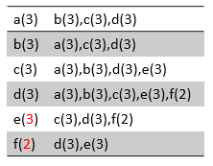
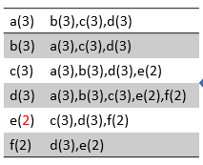
..Algorithms: Insertion
Example:
S = [e ]
S = [e, f
Input: $G\left(V,E\right)$, (x, y) inserted edge, empty set S
Output: Updated core values of all the vertices with new edge insertion in $G$
1: for any u $∈$ $V$, has both (x and y) $∈$ $V$ as the neighbors:
s = [u];
2: if c(x) = c(y): S = [u, x, y];
3: else if c(x) > c(y): S = [u, y];
4: for any vertex s in S: c(s) = c(s) + 1;
5: check is the observation holds with the above update in line 4 and update if necessary
a(3) | b(3),c(3),d(3)
b(3) | a(3),c(3),d(3)
c(3) | a(3),b(3),d(3),e(2)
d(3) | a(3),b(3),c(3),e(2)
e(2) | c(3),d(3),f(1)
f(1) | e(2)
a(3) | b(3),c(3),d(3)
b(3) | a(3),c(3),d(3)
c(3) | a(3),b(3),d(3),e(2)
d(3) | a(3),b(3),c(3),e(2)
e(2) | c(3),d(3),f(1)
f(1) | e(2)

Slide 14


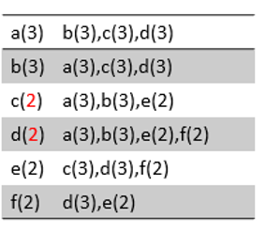
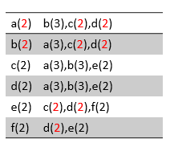
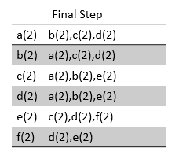
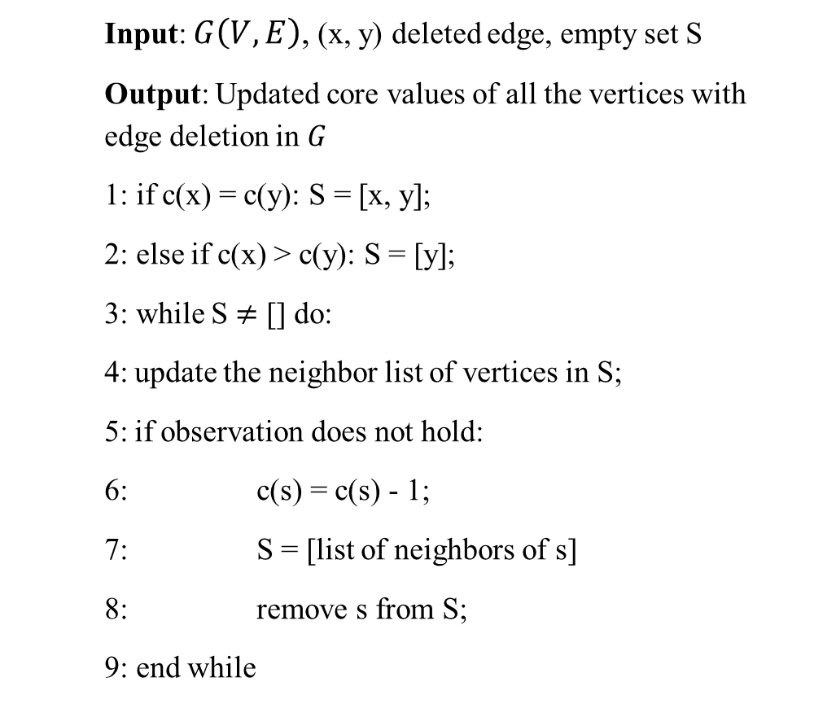
..Algorithms: Deletion
Example:
S = [ c, d,a,b,e,f
S = [ ]
S = [ c, d
S = [a,b,e,f ]
Input: $G\left(V,E\right)$, (x, y) deleted edge, empty set S
Output: Updated core values of all the vertices with edge deletion in $G$
1: if c(x) = c(y): S = [x, y];
2: else if c(x) > c(y): S = [y];
3: while S $≠$ [] do:
4: update the neighbor list of vertices in S;
5: if observation does not hold:
6: c(s) = c(s) - 1;
7: S = [list of neighbors of s]
8: remove s from S;
9: end while
a(3) | b(3),c(2),d(2)
b(3) | a(3),c(2),d(2)
c(2) | a(3),b(3),e(2)
d(2) | a(3),b(3),e(2),f(2)
e(2) | c(2),d(2),f(2)
f(2) | d(2),e(2)

Slide 15
Experiments
File name | Graph Type | # of nodes | # of edges | File size in MB
com-facebook.combined.txt | Social circles from Facebook | 63,731 | 817,035 | 12
com-dblp.ungraph.txt | DBLP collaboration network | 1,314,050 | 5,362,414 | 13.2
com-youtube.ungraph.txt | YouTube online social network | 3,223,589 | 9,375,374 | 36
com-lj.ungraph.txt | LiveJournal online social network | 4,846,609 | 42,851,237 | 478
com-orkut.ungraph.txt | Orkut online social network | 3,072,441 | 117,185,083 | 1640
[4]
All experiments are conducted on a Ubuntu (20.04 LTS) server with Intel(R) Xeon(TM) W-2123 CPU, 192G RAM, and 4TB hard disk.

Slide 16
..Experiments
The experiments are conducted in 2 phases:
Performance comparison with Naïve Core Decomposition algorithm [2]
Performance comparison with Order-Based Algorithm [3]

Slide 17
..Experiments
Experiment 1: Performance comparison between our modified observation algorithm and Naïve core decomposition algorithm (based on time)

Slide 18
..Experiments
Experiment 1: Performance comparison between our modified observation algorithm and Naïve core decomposition algorithm (based on memory usage)
File | Modified Core Observation (MB) | Naïve Core Decomposition (MB)
com-facebook | 143 | 167
com-dblp | 175 | 634
com-youtube | 714 | 2317
com-lj | 3714 | 8821
com-orkut | 5212 | OOM*
*OOM : Out of Memory

Slide 19
..Experiments
Experiment 2: Performance comparison between our modified insertion and deletion algorithm and Order-based insertion and deletion algorithm (based on time)

Slide 20
..Experiments
Experiment 2: Performance comparison between our modified insertion and deletion algorithm and Order-based insertion and deletion algorithm (based on memory usage)
File | Modified Edge Insert/Deletion (MB) | Order Insertion/Deletion (MB)
com-facebook | 18.6 | 21
com-dblp | 132 | 157
com-youtube | 199 | 200
com-lj | 469 | 539

Slide 21
Conclusion
Proposed a modified algorithm to maintain the core values in a dynamic changing real-world graph.
Implemented the algorithms in Java
Tested the results of our algorithm with previous known and proposed algorithms.

Slide 22
Future Works
We aim to test run on larger dynamic data using distributed computing to verify the scalability and memory utilization.
We plan to generate a hands-on user experience where the user can visually interact with the graph data and its subgraph with the core values maintain for the vertices in the graph

Slide 23
References
[1] https://blog.twitter.com/engineering/en_us/topics/insights/2021/temporal-graph-networks
[2] S. Seidman. Network structure and minimum degree. Social Networks, 5(3):269–287, 1983
[3] Saríyüce, Ahmet Erdem, et al. "Streaming algorithms for k-core decomposition." Proceedings of the VLDB Endowment 6.6 (2013): 433-444.
[4] Zhang, Yikai, et al. "A fast order-based approach for core maintenance." 2017 IEEE 33rd International Conference on Data Engineering (ICDE). IEEE, 2017.
[5] SNAP. Stanford network analysis package– URL: https://snap.stanford.edu/data/index.html
Github link : https://github.com/yumikansakar/Efficient-Core-Maintenance-in-Dynamic-Graphs.git

Slide 24
Thank You

